Slide 1
Pathways to Ontario’s Knowledge Economy:
A system for identifying existing
regional strengths and future prospects
Richard Florida, University of Toronto
Shade Shutters, Arizona State University
Gregory M. Spencer, University of Toronto
Regional Studies - Atlanta
June 15, 2016

Slide 2
An unprecedented period of political alignment
“we must avoid a race to the bottom and instead participate in the parts of the economy which pay more but where we are competitive…we must double down on winners”
– Ed Clark, Chair of Premier’s Advisory Council
“my predecessor wanted you to know Canada for its resources. I want you to know Canadians for our resourcefulness”
– Justin Trudeau, Prime Minister
“truly innovative economies and ecosystems are anti-fragile. They aren’t just resilient in the face of change – they thrive on it. This is the economy we envision for a Southern Ontario innovation supercluster driven by Toronto, Waterloo and Hamilton”
Patrick Deane, President and Vice-chancellor of McMaster University
Meric Gertler, President of the University of Toronto
Feridun Hamdullahpur, President and Vice-chancellor of the University of Waterloo

Slide 3
Economic and policy context
Recognition that innovation and creativity are main drivers of economic prosperity
- launching of national ‘innovation agenda’ year-long consultation
- similar consultation underway in Ontario
Acknowledges local/regional approach
- cluster approach to economic development now official legislation in ON
- national cluster portal announced in 2016 Federal Budget
Understanding that economies are path-dependent
- evolutionary approach to local economic development policy making

Slide 4
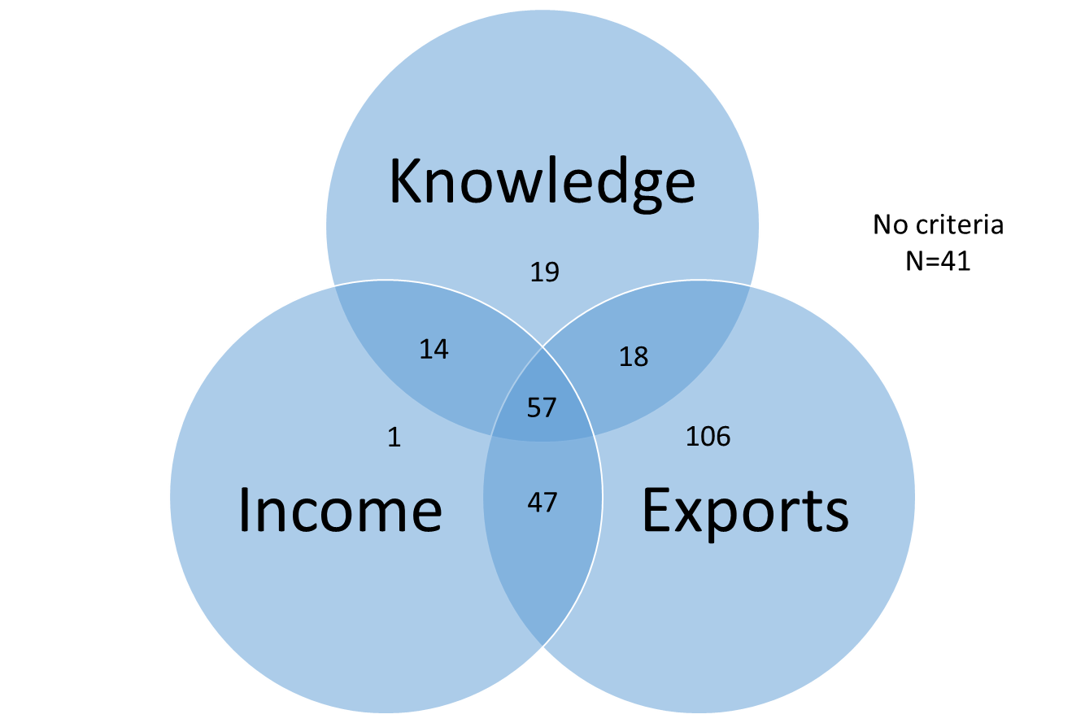
Basic criteria for identifying target industries
Knowledge intensity
Criteria = creative class employment >30%
Income
Criteria = above average full-time employment income
Exports
Criteria = excludes public sector; retail; consumer services; select others
Final set
Criteria = exporting + 1 of 2 other criteria
N = 122 (of possible 303 4-digit NAICS)

Slide 5
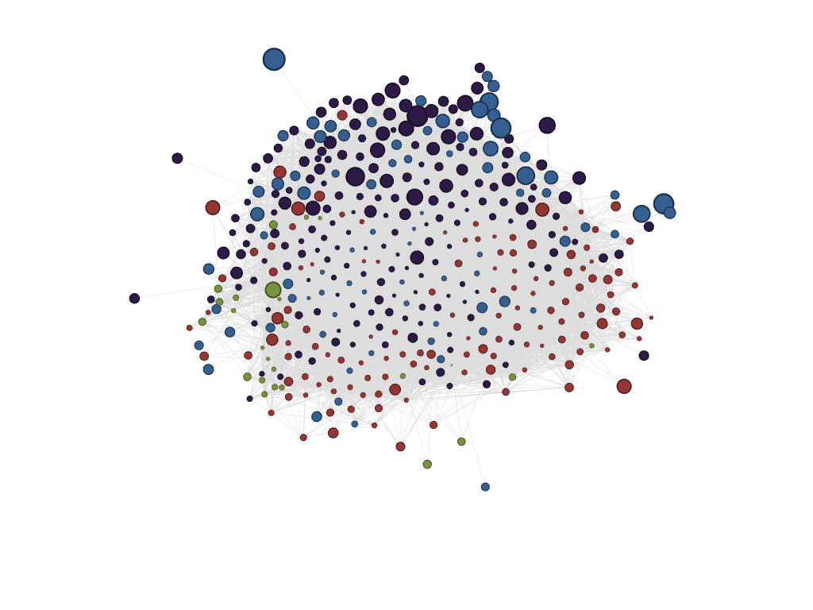
Specific regional criteria for identifying target industries
Labour Market Suitability
Criteria = matching of matrices of co-locating occupations for each industry and each region (see next slide)
Local Specialization
Criteria = location quotient > 1
Industry Size
Criteria = total local employment (minimum 100 + rank)
Local Industry Income
Criteria = full-time employment income (rank)

Slide 6
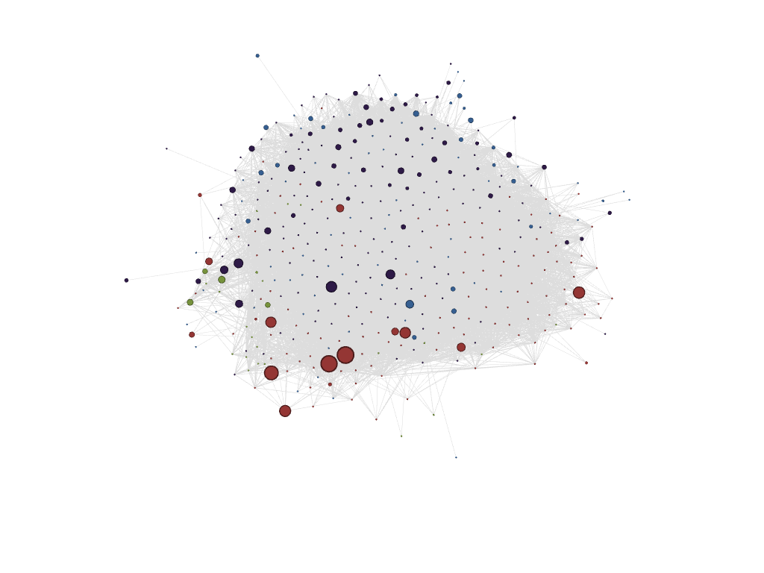
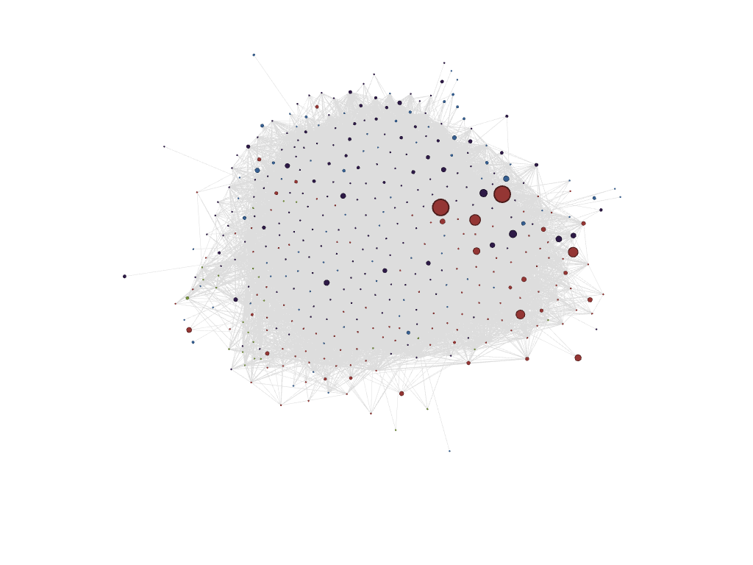
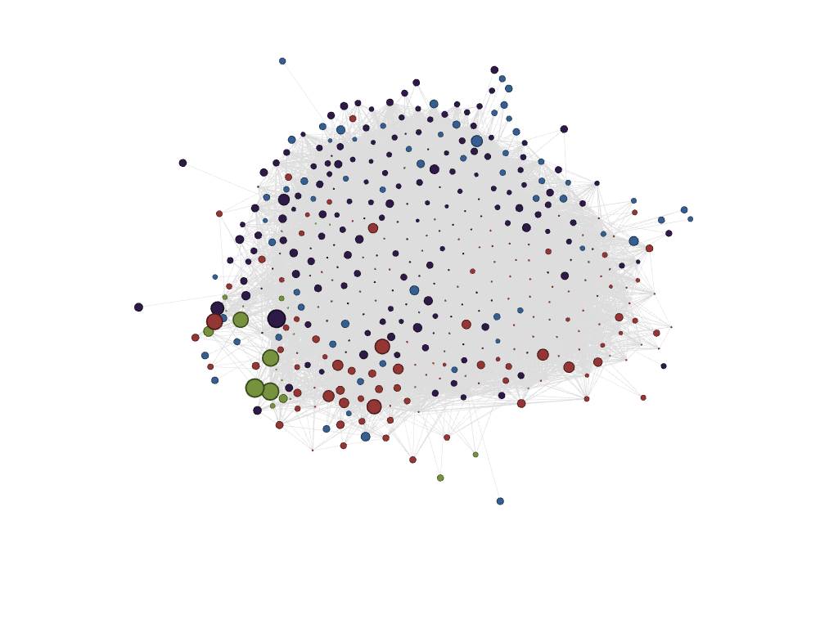
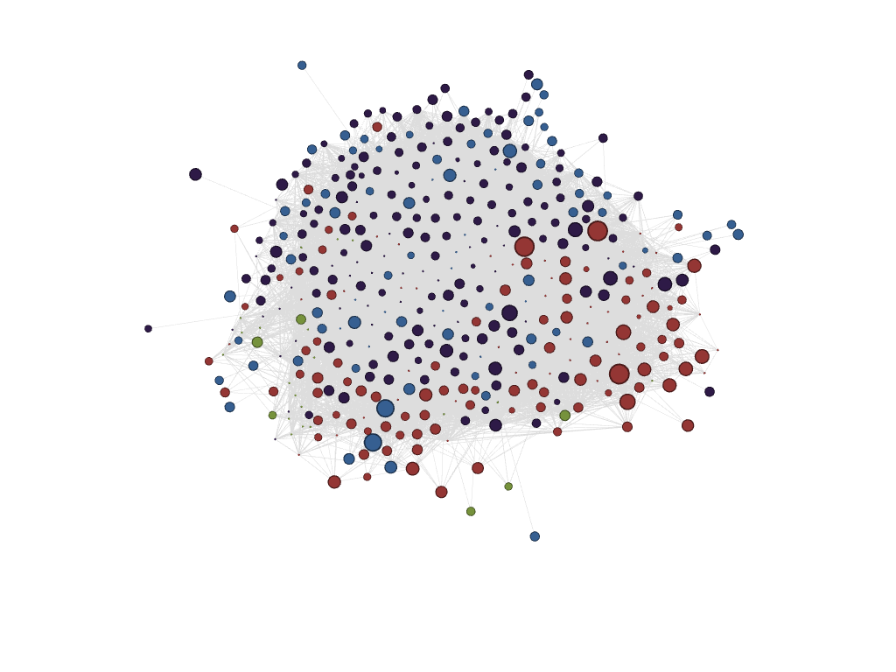
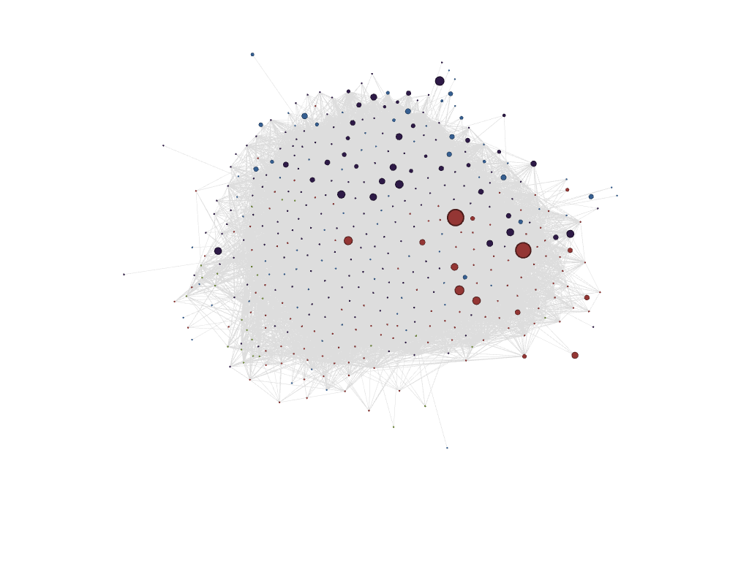
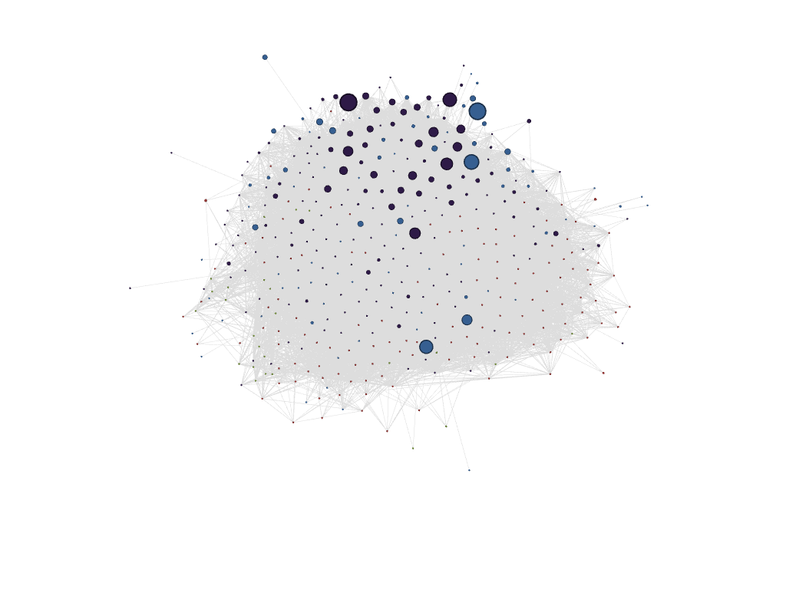
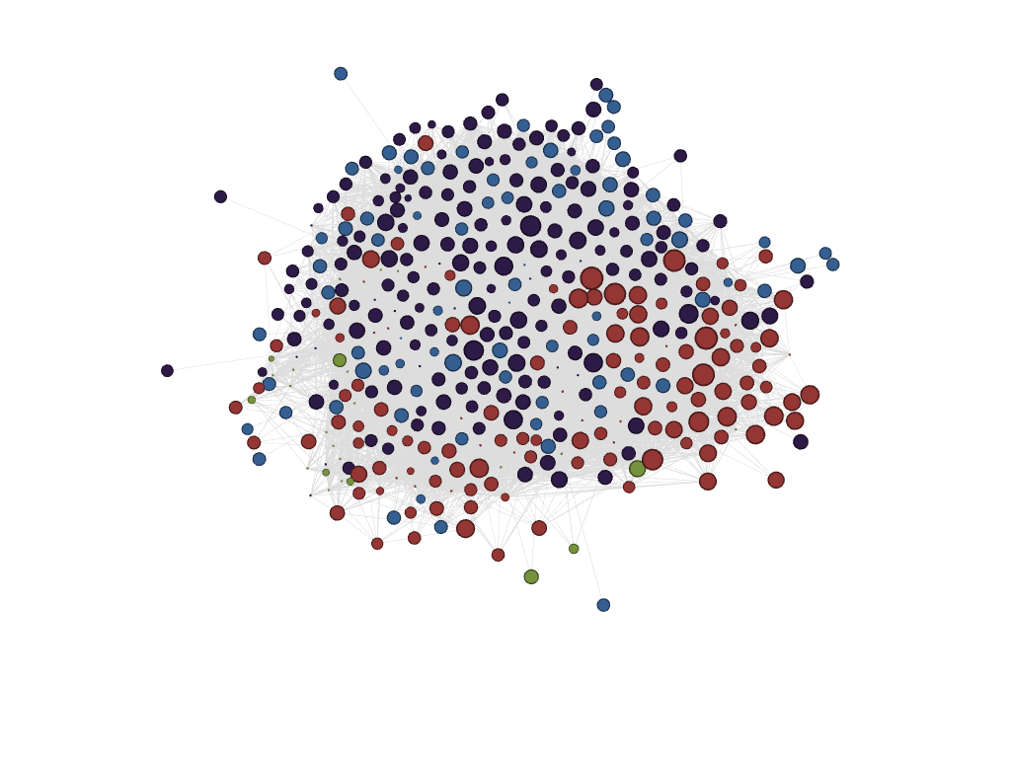
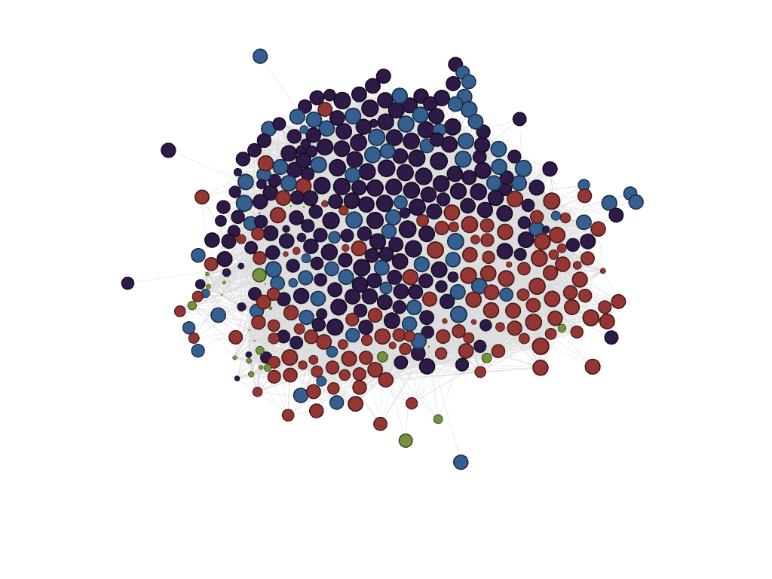
Labour Market Suitability Index – Matching occupational matrices between industries and regions
NAICS 2122 (Mining)
NAICS 3361 (Auto mfg.)
Sudbury
Windsor
NAICS 3341 (ICT Mfg.)
NAICS 5112 (Banking)
Kitchener-Waterloo
Toronto

Slide 7
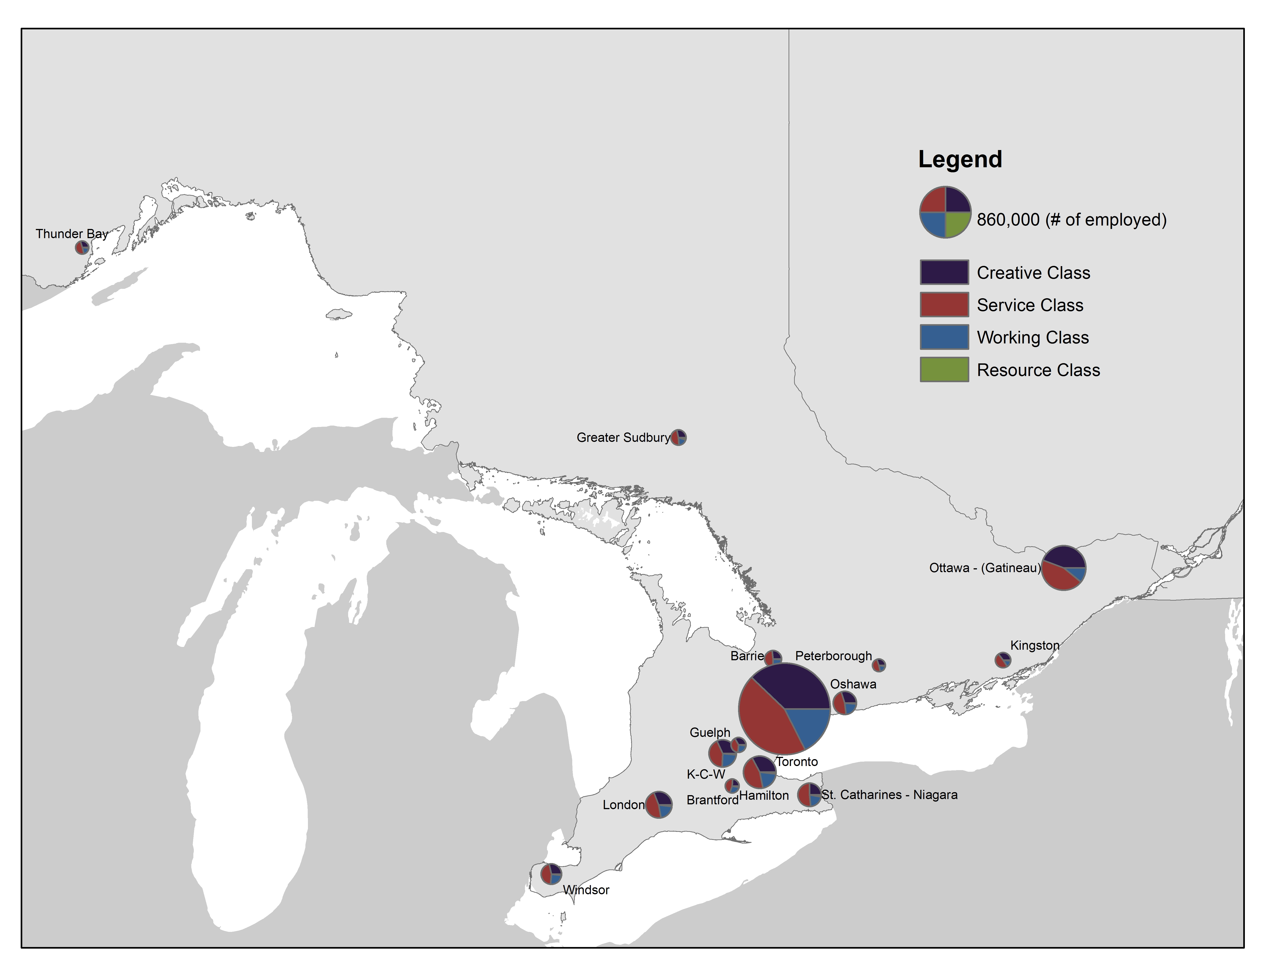
Comparing the city-regions of Ontario
15 Census metropolitan regions in Ontario
Regions of at least 100,000
Divided into 3 groups for the report
‘Supercluster’ (Toronto, Hamilton, Kitchener-Waterloo, Guelph, Oshawa)
Southwestern Ontario (London, Windsor, Brantford, St. Catharines-Niagara)
Eastern, Central, Northern Ontario (Ottawa, Kingston, Peterborough, Barrie, Sudbury, Thunder Bay)

Slide 8
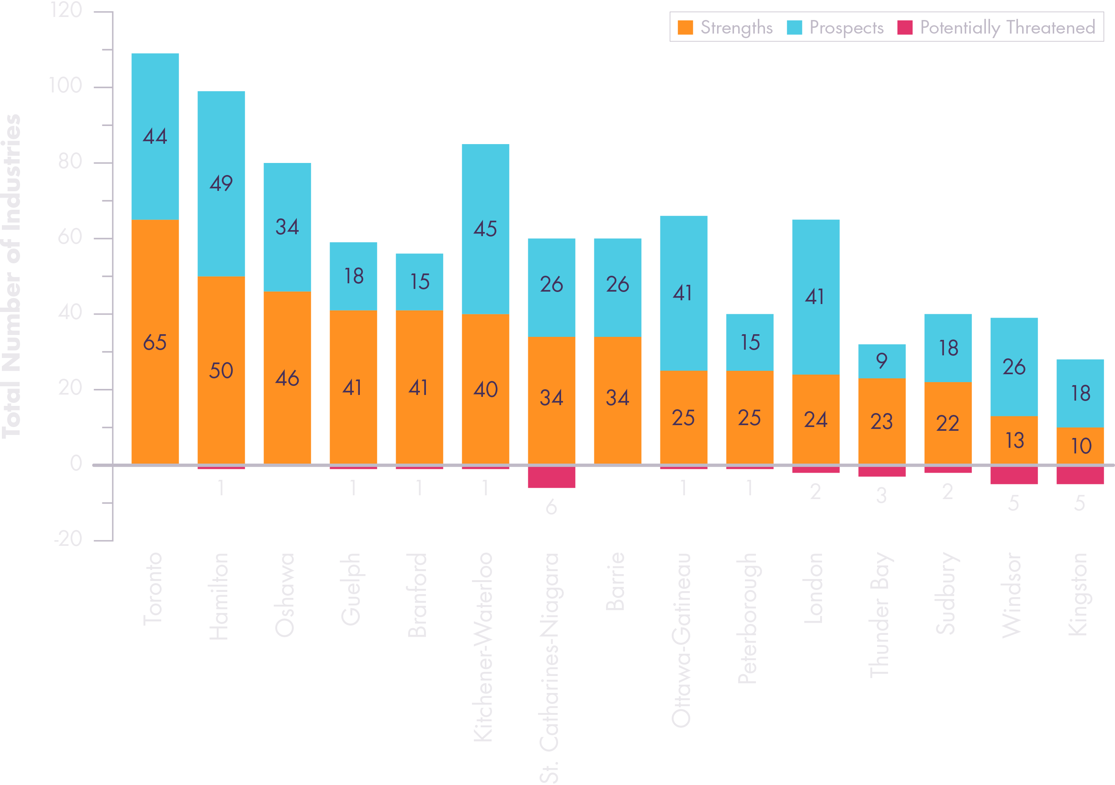
Unequal strengths, unequal prospects
Existing strengths
LMS > 1 + LQ > 1 + labour market >100
Future prospects
LMS > 1 + LQ < 1 + labour market > 100
Potentially threatened
LMS < 1 + LQ > 1

Slide 9
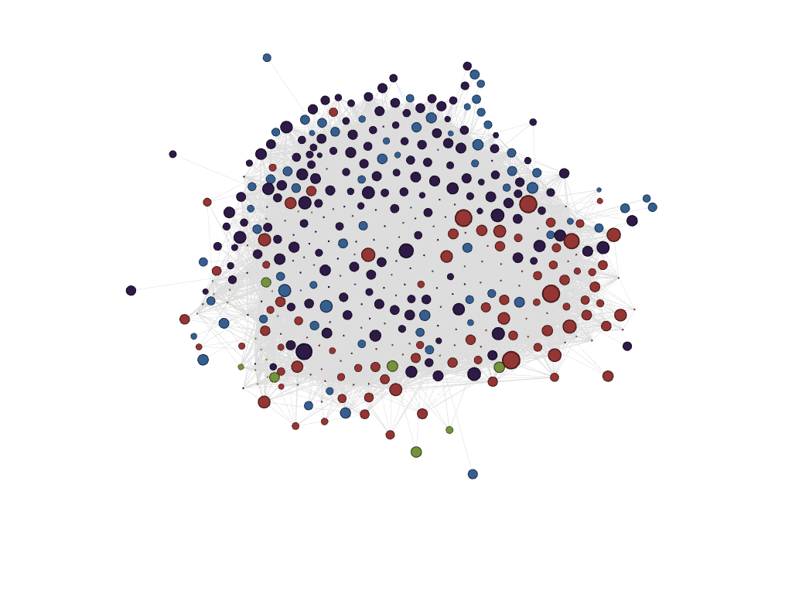
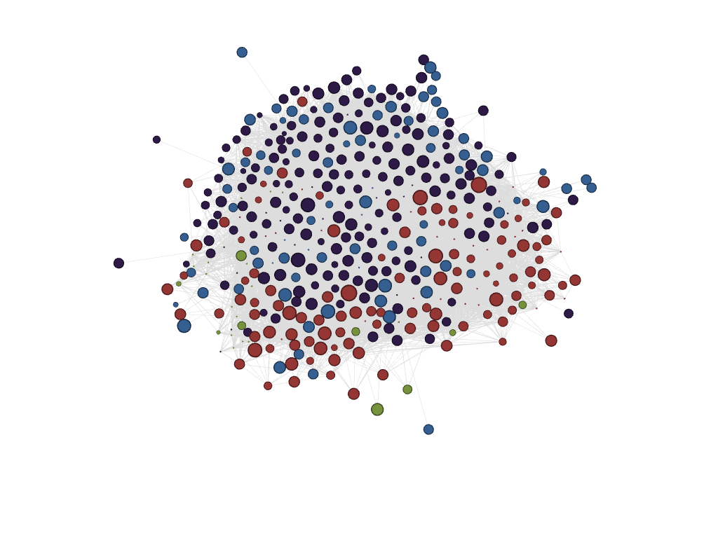
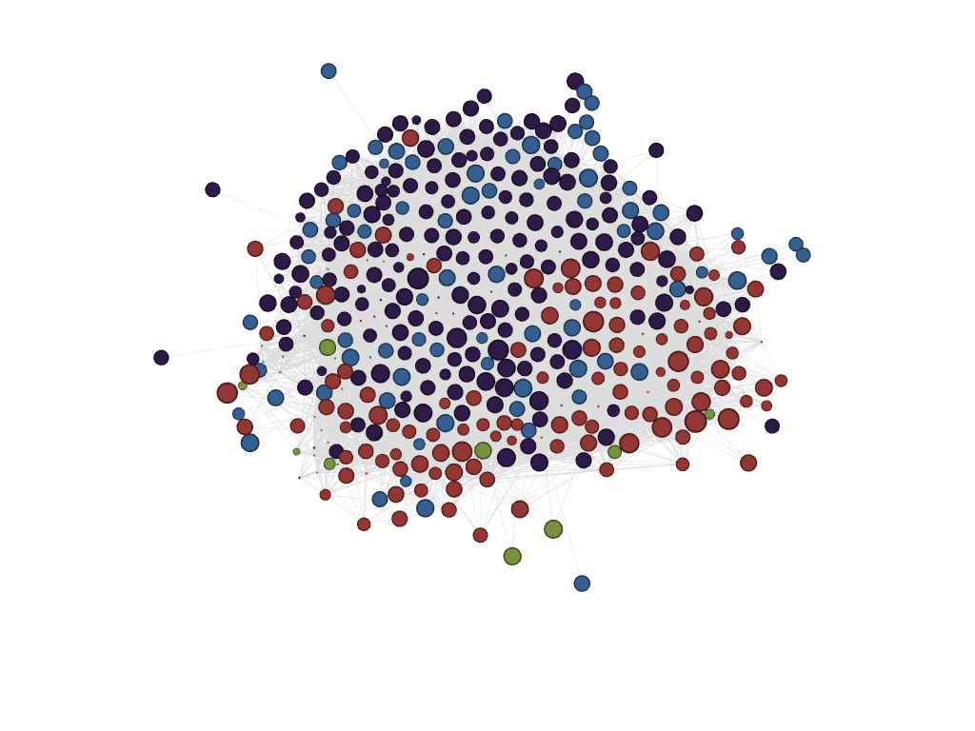
The emerging ‘super cluster’ centered on Toronto
Guelph
Oshawa
Toronto
Kitchener-Waterloo
Hamilton

Slide 10
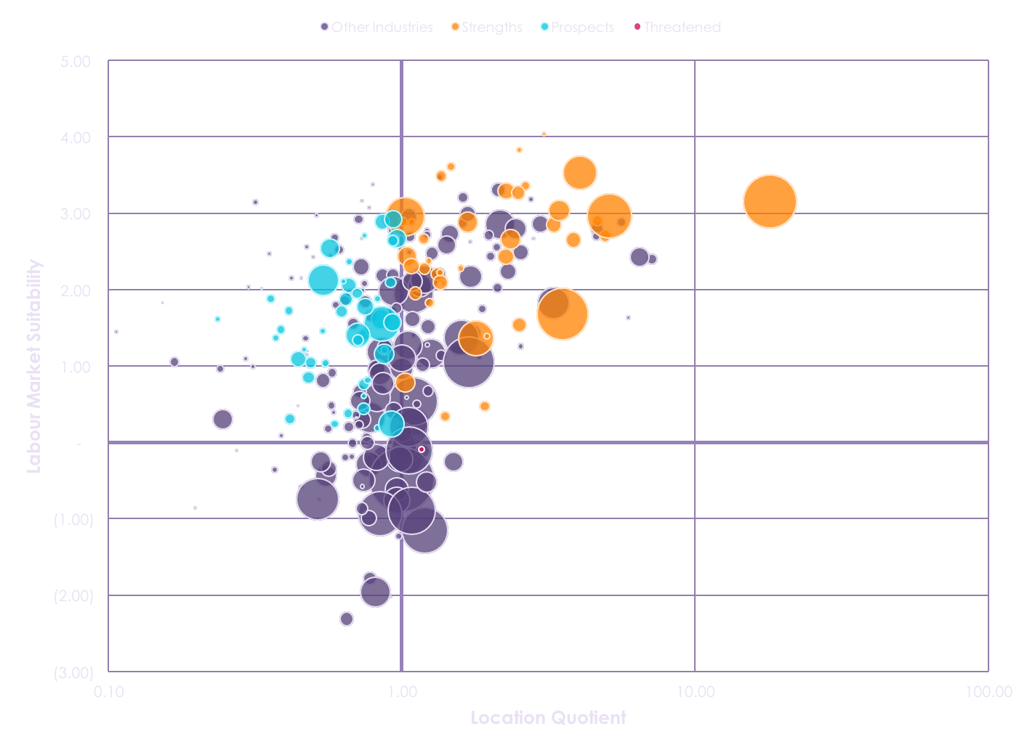
A profile of the Kitchener-Waterloo region
NAICS Code | Industry Description | Labour Market Suitability | Location Quotient | Labour Market Size | Average Full-time Employment Income
3342 | Communications equipment manufacturing | 3.16 | 17.99 | 7,620 | $ 78,621
3361 | Motor vehicle manufacturing | 3.53 | 4.05 | 3,120 | $ 74,469
3345 | Navigational, measuring, medical and control instruments manufacturing | 3.29 | 2.27 | 830 | $ 71,520
3339 | Other general-purpose machinery manufacturing | 3.03 | 3.44 | 1,295 | $ 65,625
5112 | Software publishers | 2.66 | 2.35 | 1,160 | $ 87,524
3363 | Motor vehicle parts manufacturing | 2.96 | 5.10 | 5,420 | $ 61,087
5241 | Insurance carriers | 1.68 | 3.53 | 7,235 | $ 68,149
3353 | Electrical equipment manufacturing | 3.27 | 2.49 | 580 | $ 66,550
5415 | Computer systems design and related services | 2.95 | 1.03 | 4,075 | $ 74,156
3333 | Commercial and service industry machinery manufacturing | 2.85 | 3.30 | 690 | $ 64,365
NAICS Code | Industry Description | Labour Market Suitability | Labour Market Size | Average Full-time Employment Income
4173 | Computer and communications equipment and supplies wholesaler-distributors | 2.92 | 945 | $ 86,316
5239 | Other financial investment activities | 1.61 | 1,080 | $100,505
5221 | Depository credit intermediation | 2.12 | 2,700 | $ 70,364
5413 | Architectural, engineering and related services | 1.55 | 3,475 | $ 78,034
3364 | Aerospace product and parts manufacturing | 2.89 | 685 | $ 69,748
5171 | Wired telecommunications carriers | 2.54 | 1,075 | $ 69,017
4179 | Other machinery, equipment and supplies wholesaler-distributors | 2.66 | 1,005 | $ 67,101
5231 | Securities and commodity contracts intermediation and brokerage | 1.71 | 425 | $139,056
5417 | Scientific research and development services | 1.57 | 895 | $ 78,658
5416 | Management, scientific and technical consulting services | 1.40 | 1,675 | $ 76,211

Slide 11
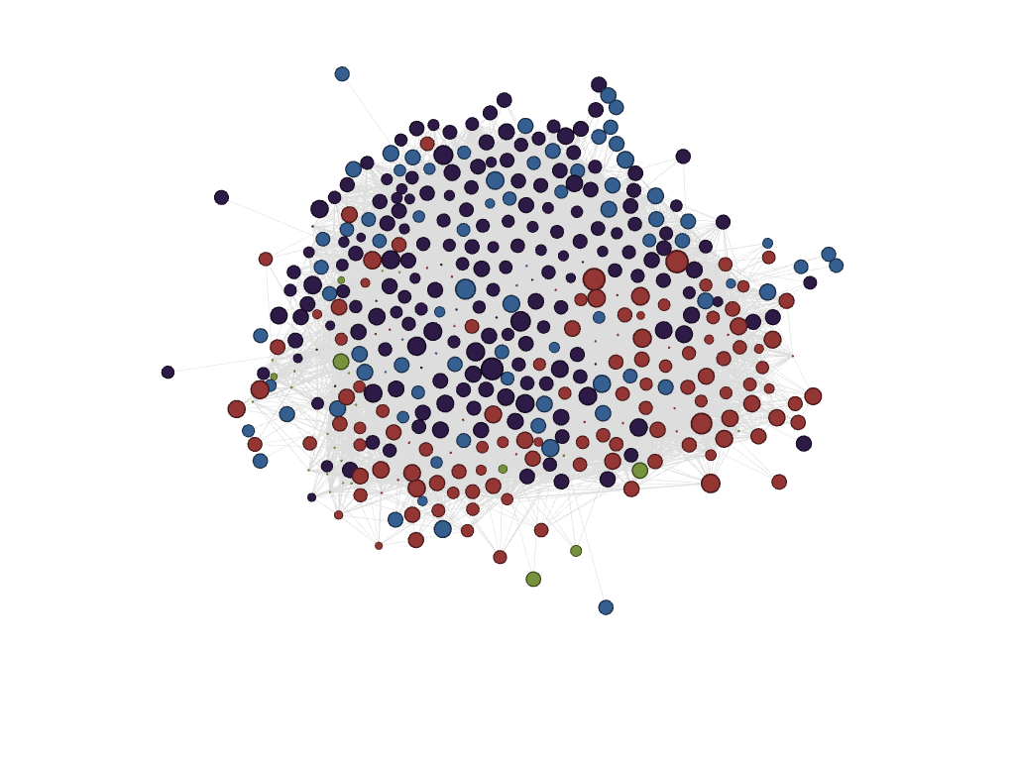
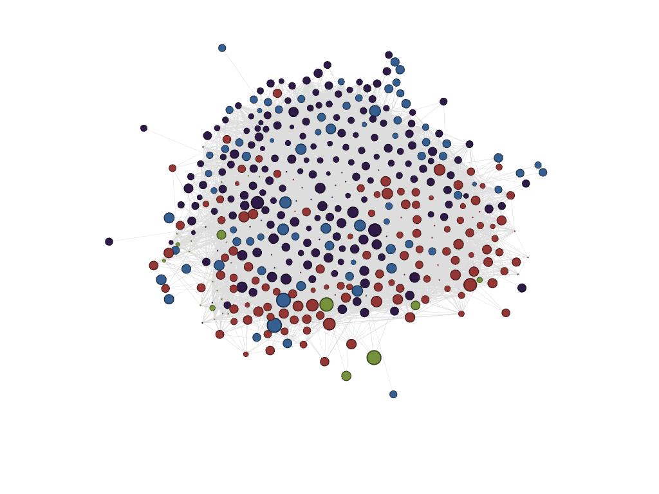
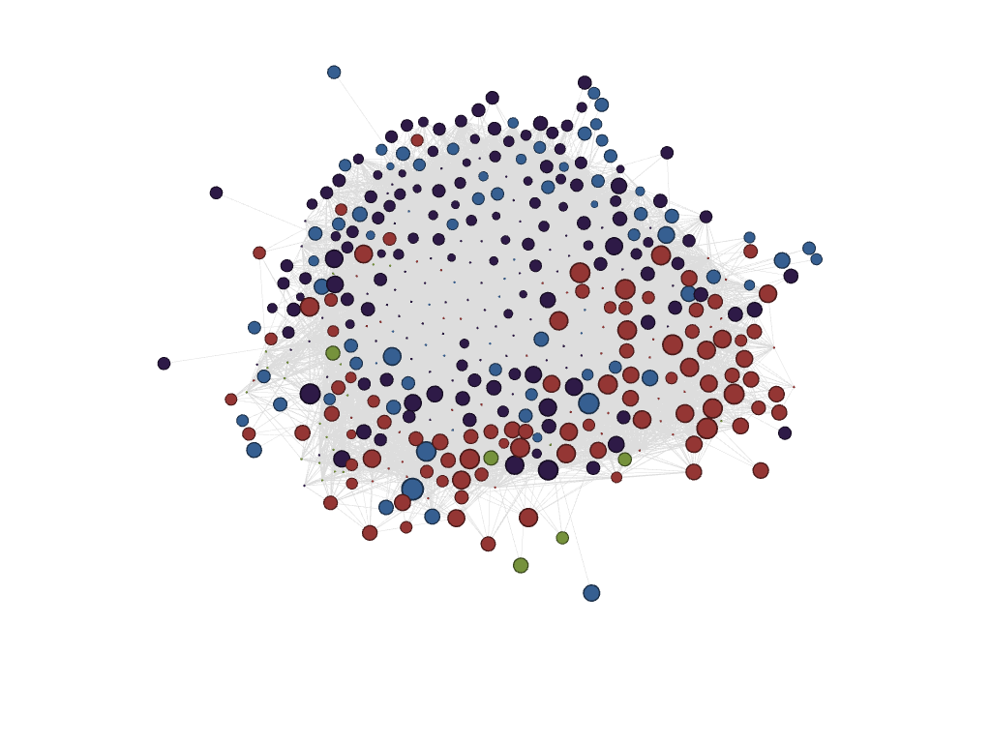
Southwestern Ontario – the epicenter of auto manufacturing in Canada
London
St. Catharines-Niagara
Windsor
Brantford

Slide 12
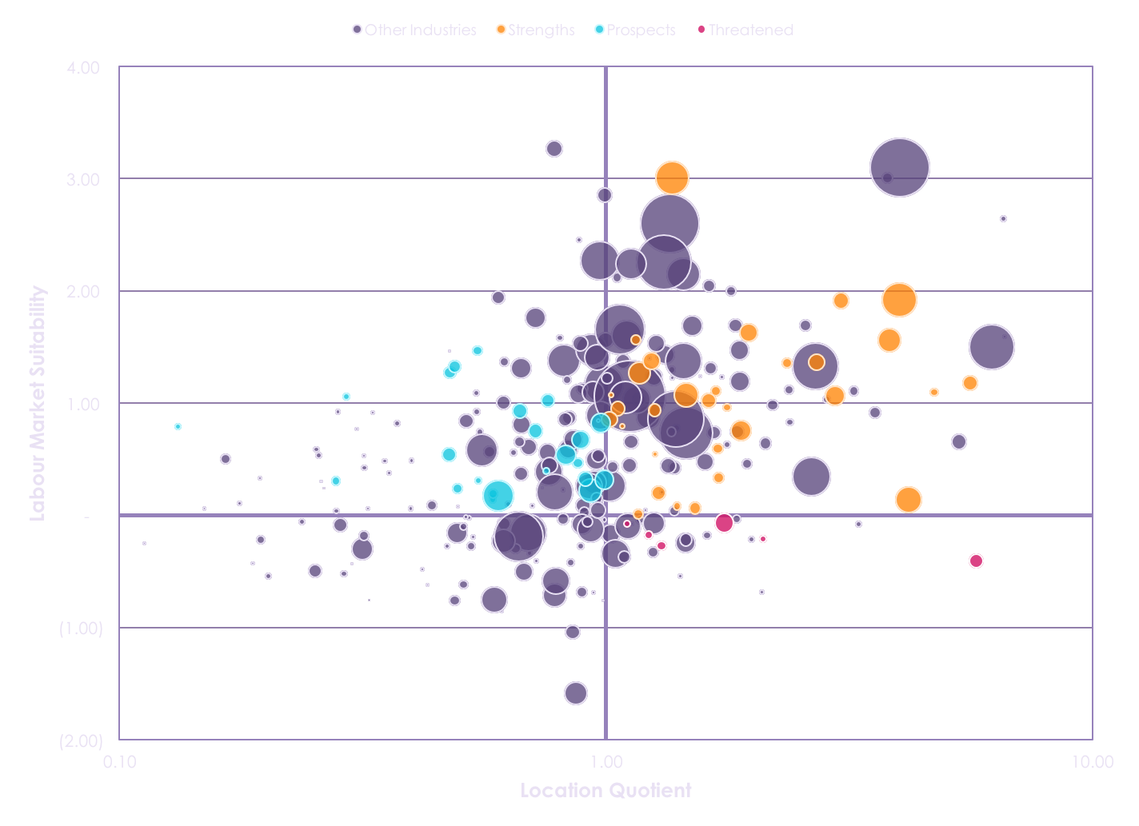
A profile of the St. Catharine’s – Niagara region
NAICS Code | Industry Description | Labour Market Suitability | Location Quotient | Labour Market Size | Average Full-time Employment Income
3361 | Motor vehicle manufacturing | 1.92 | 4.01 | 2,270 | $ 74,469
3311 | Iron and steel mills and ferro-alloy manufacturing | 1.06 | 2.95 | 755 | $ 68,221
7121 | Heritage institutions | 1.56 | 3.83 | 1,025 | $ 52,441
4162 | Metal service centres | 1.37 | 2.72 | 545 | $ 64,164
3312 | Steel product manufacturing from purchased steel | 1.18 | 5.62 | 455 | $ 63,687
2362 | Non-residential building construction | 1.27 | 1.17 | 940 | $ 74,494
2373 | Highway, street and bridge construction | 1.37 | 1.24 | 585 | $ 71,896
3121 | Beverage manufacturing | 0.14 | 4.19 | 1,245 | $ 65,704
7112 | Spectator sports | 1.91 | 3.04 | 525 | $ 47,523
4831 | Deep sea, coastal and great lakes water transportation | 1.36 | 2.36 | 225 | $ 66,999
7111 | Performing arts companies | 1.63 | 1.97 | 650 | $ 42,578
NAICS Code | Industry Description | Labour Market Suitability | Labour Market Size | Average Full-time Employment Income
4172 | Construction, forestry, mining, and industrial machinery, equipment and supplies wholesaler-distributors | 0.82 | 735 | $ 71,391
4821 | Rail transportation | 1.47 | 195 | $ 76,014
2211 | Electric power generation, transmission and distribution | 0.22 | 1,075 | $ 92,566
4179 | Other machinery, equipment and supplies wholesaler-distributors | 0.67 | 680 | $ 67,101
3364 | Aerospace product and parts manufacturing | 0.75 | 420 | $ 69,748
5413 | Architectural, engineering and related services | 0.18 | 1,790 | $ 78,034
4851 | Urban transit systems | 1.27 | 305 | $ 62,709
2131 | Support activities for mining and oil and gas extraction | 0.79 | 105 | $ 93,079
5121 | Motion picture and video industries | 1.33 | 340 | $ 56,839
3345 | Navigational, measuring, medical and control instruments manufacturing | 0.47 | 235 | $ 71,520

Slide 13
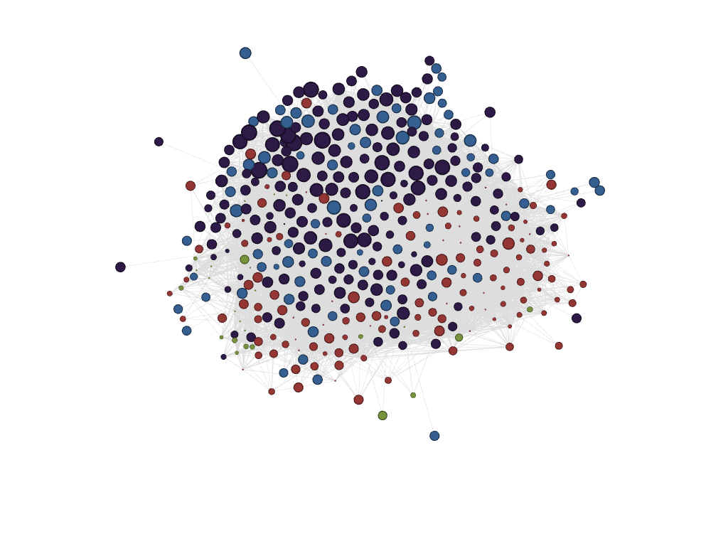
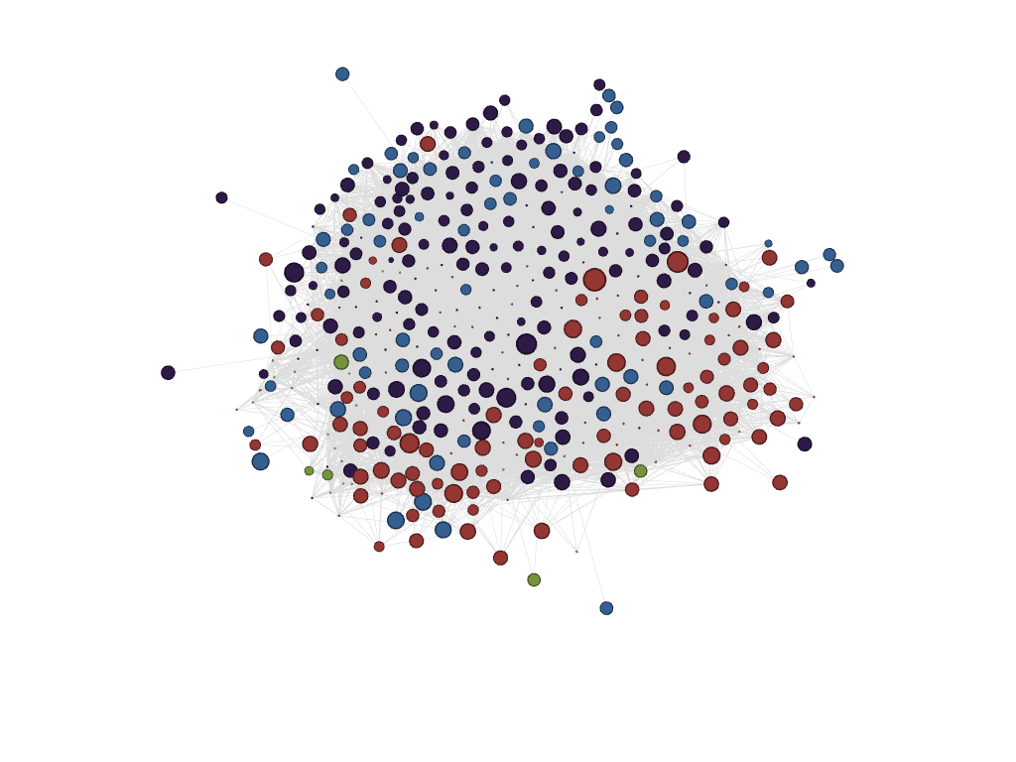
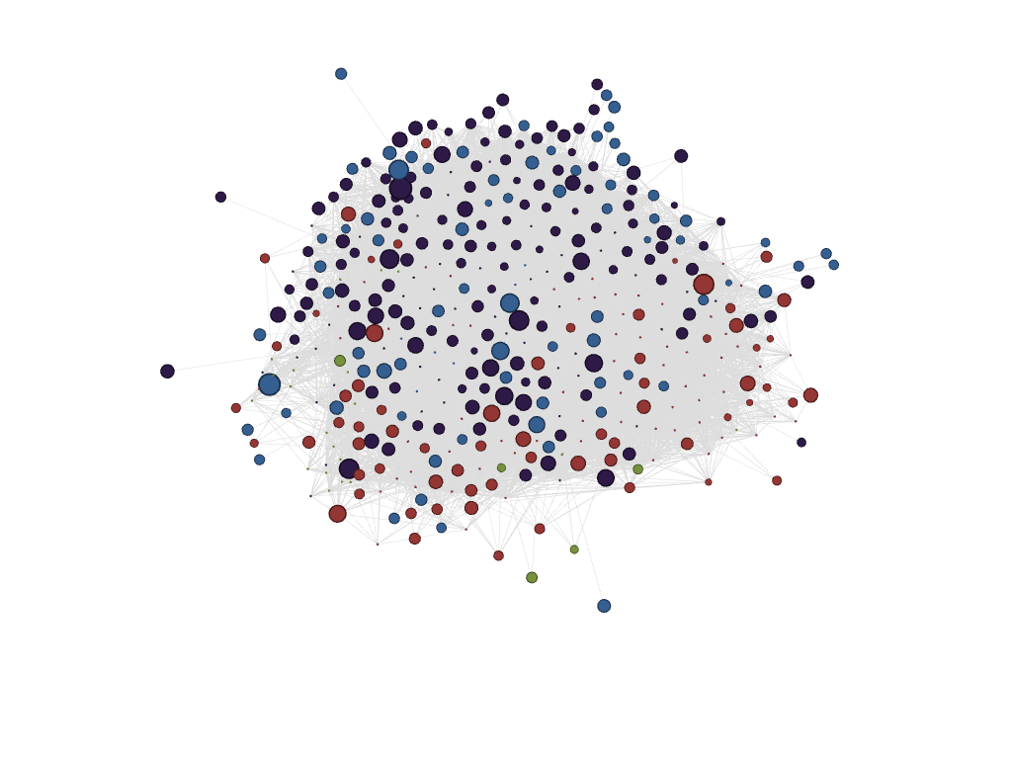
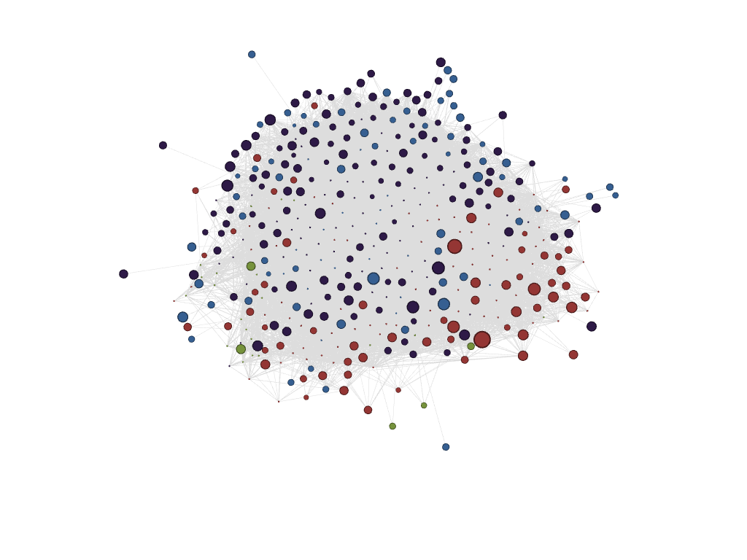
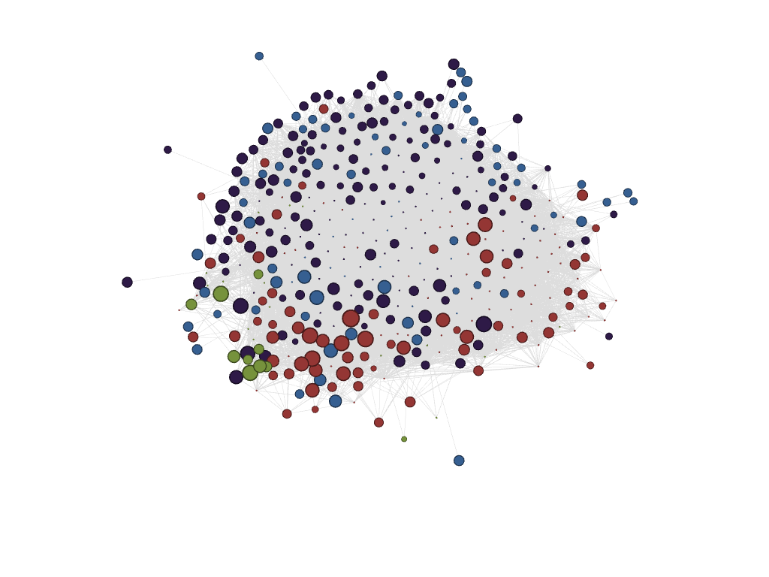
Eastern, Central, and Northern Ontario – limited prospects for differing reasons
Ottawa-Gatineau
Barrie
Sudbury
Kingston
Peterborough
Thunder Bay

Slide 14
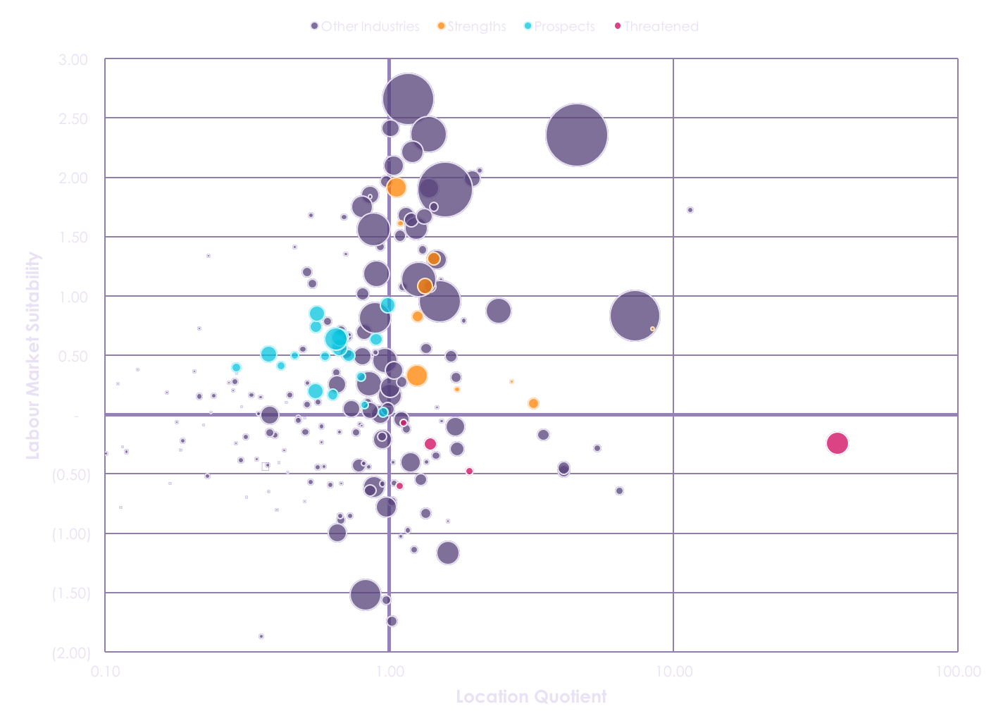
A profile of the Kingston region
NAICS Code | Industry Description | Labour Market Suitability | Location Quotient | Labour Market Size | Average Full-time Employment Income
5417 | Scientific research and development services | 1.08 | 1.33 | 400 | $ 78,658
5191 | Other information services | 1.31 | 1.43 | 305 | $ 59,666
5242 | Agencies, brokerages and other insurance related activities | 0.33 | 1.25 | 740 | $ 63,561
2213 | Water, sewage and other systems | 0.09 | 3.21 | 200 | $ 67,221
4832 | Inland water transportation | 0.72 | 8.41 | 35 | $ 59,105
7139 | Other amusement and recreation industries | 1.91 | 1.06 | 680 | $ 39,482
5179 | Other telecommunications | 0.21 | 1.73 | 70 | $ 62,729
7112 | Spectator sports | 1.61 | 1.09 | 80 | $ 47,523
3271 | Clay product and refractory manufacturing | 0.28 | 2.70 | 35 | $ 51,049
7115 | Independent artists, writers and performers | 0.83 | 1.26 | 235 | $ 29,917
NAICS Code | Industry Description | Labour Market Suitability | Labour Market Size | Average Full-time Employment Income
5411 | Legal services | 0.65 | 490 | $ 96,617
5413 | Architectural, engineering and related services | 0.64 | 820 | $ 78,034
5416 | Management, scientific and technical consulting services | 0.85 | 410 | $ 76,211
2211 | Electric power generation, transmission and distribution | 0.74 | 270 | $ 92,566
5415 | Computer systems design and related services | 0.51 | 465 | $ 74,156
5239 | Other financial investment activities | 0.50 | 285 | $100,505
5241 | Insurance carriers | 0.56 | 425 | $ 68,149
5419 | Other professional, scientific and technical services | 0.92 | 405 | $ 55,029
5412 | Accounting, tax preparation, bookkeeping and payroll services | 0.20 | 420 | $ 69,979
5111 | Newspaper, periodical, book and director publishers | 0.63 | 280 | $ 57,953

Slide 15
Highly differentiated regions with varying degree of strengths and prospects
GTHA ‘Super cluster’
many industrial strengths & key knowledge institutions
issues of inequality and affordability
Southwestern Ontario
heavily dependent on auto manufacturing
must lead development of changes in the industry or shift to related activities
Eastern, Central, Northern Ontario
highly specialized economies
need diversification strategies especially with regards to HVA activities

Slide 16
Policy recognitions and mechanisms
Recognition: highly differentiated regional economies
Mechanism: cluster based ED policies – local strengths and industry needs
Recognition: cannot reinvent local economies from scratch
Mechanism: tailor ED policies to current labour market skills
Recognition: knowledge-based economic activities are key
Mechanism: tighter alignment of higher education with local economies
Recognition: labour market not the only signal
Mechanism: need to pair with technology profiles & other knowledge assets

Slide 17
Thank you
martinprosperity.org
greg.spencer@rotman.utoronto.ca

