Slide 1
Anchors Away!
The evolution of an ICT cluster
after the sinking of its flagship company
4th Global Conference in Economic Geography
Oxford, UK, April 19-24, 2015
Dieter F Kogler
University College Dublin
Gregory M Spencer
University of Toronto

Slide 2
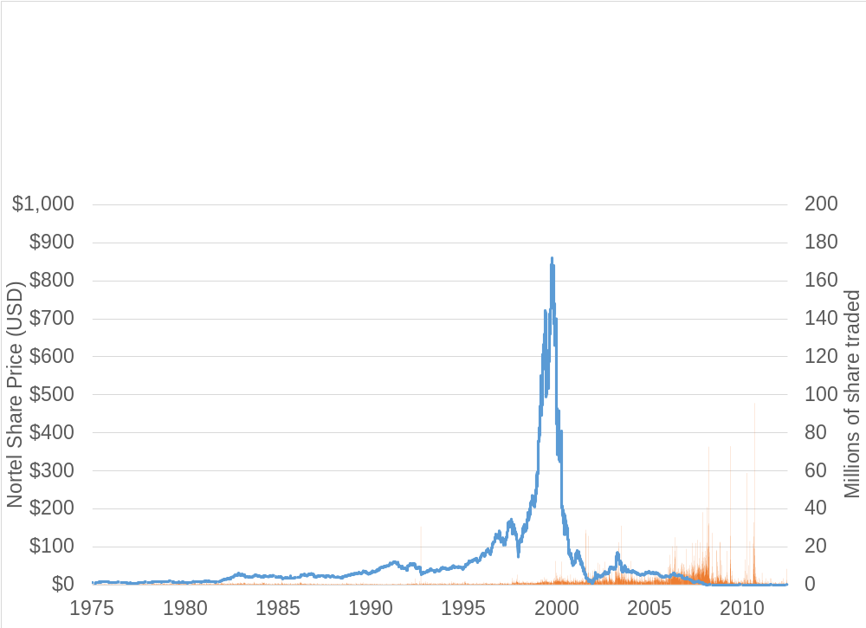

The spectacular rise and fall of Nortel Networks
On January 14, 2009 Nortel files for bankruptcy in multiple jurisdictions and by 2010 has fewer than 2,000 employees
At its peak in 2000 Nortel accounted for over one third of the total value of the TSX and employed nearly 100,000 people worldwide

Slide 3
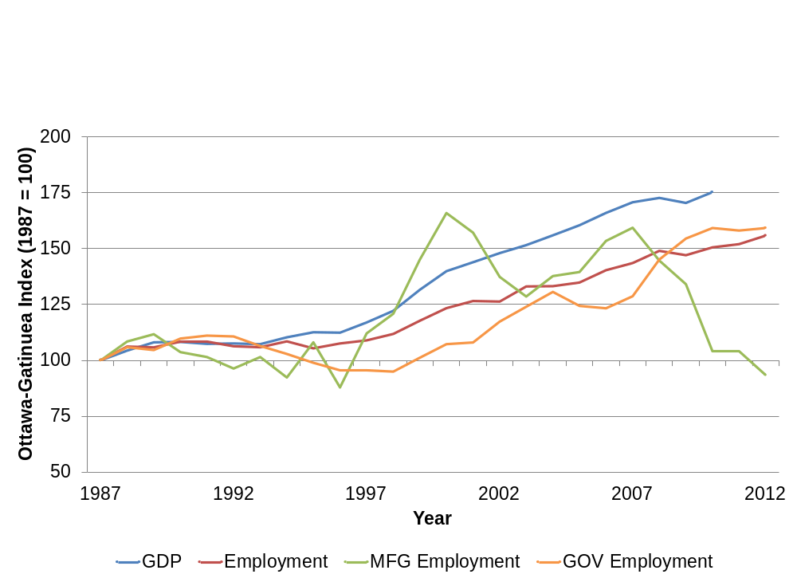
Local impact not as severe as expected

Slide 4
Nortel had a highly inventive history
In June 2011 over 6,000 of Nortel’s patents were sold to a consortium of companies (Apple, EMC, Ericsson, Microsoft, RIM, and Sony) for over $4 billion

Slide 5
Research Questions
How resilient was the Ottawa-Gatineau ICT cluster in response to the collapse of Nortel?
What happened to Nortel’s inventive capacity?
  Did it remain? Leave? Dissipate?
What were the main sources of the ICT cluster’s resiliency?
  Creative destruction/entrepreneurship?
  New entries (from elsewhere)
  Existing firms

Slide 6
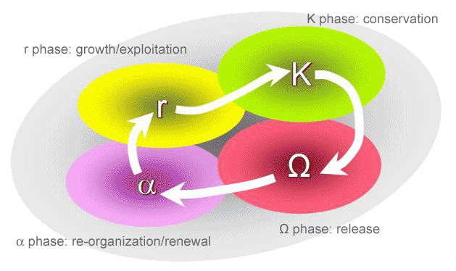
Literature
Building on the University of Ottawa study (Calof et al 2014) that investigated why Nortel collapsed this paper looks at the impact of the collapse (and why it wasn’t as severe as may have been expected)
Three related literatures
  Clusters & local ecosystems
  Evolutionary economic geography
  Local/regional resiliency
Systems approach to understanding adaptive cycles
“panarchy” as a way of understanding adaptive systems across multiple scales (Holling et al 2002)
Source: resilience.org

Slide 7
Approach and Methods
A case study approach using patent data in order to describe the evolution of the inventive capacity of the Ottawa-Gatineau ICT cluster through various stages
Using Kogler’s patent database for Canada (from USPTO) to track inventors who had at some point filed a patent for Nortel or one of its units/subsidiaries
Identify where former Nortel inventors went during and after the company’s collapse (i.e. new firms; existing firms; local/non-local)
Classify assignees into categories (i.e. direct competitors, existing firms, startups)

Slide 8
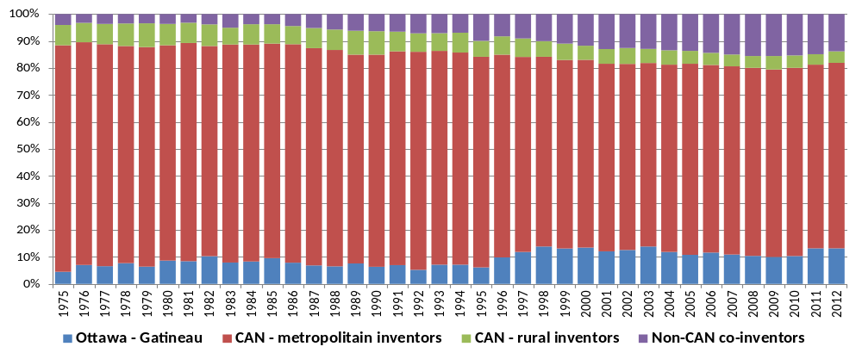
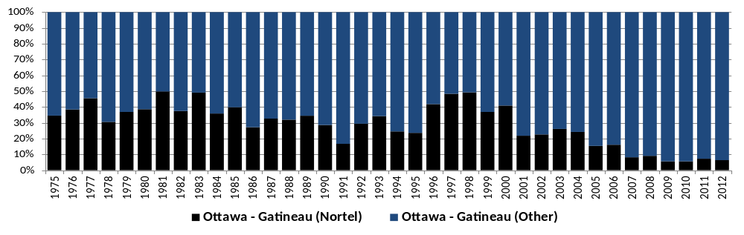
Ottawa-Gatineau Inventor Population

Slide 9
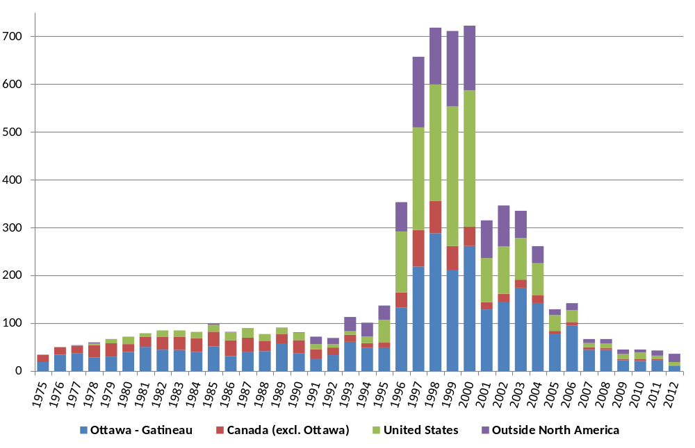
Nortel patents over time

Slide 10
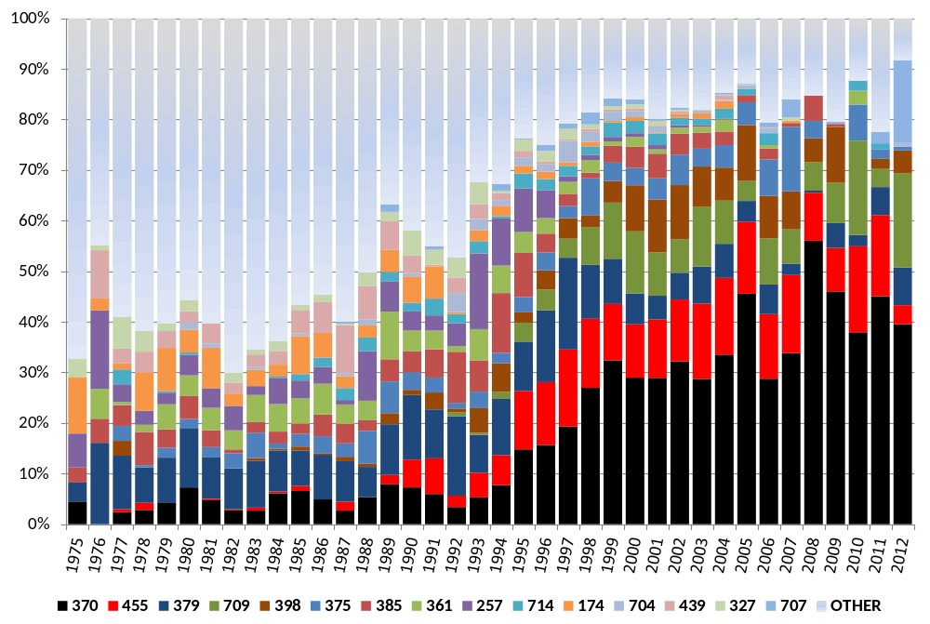
Change in Nortel tech over time
370 Multiplex communications
455 Telecommunications
379 Telephonic communications
709 Electrical computers and digital processing systems: multicomputer data transferring
398 Optical communications
375 Pulse or digital communications
385 Optical waveguides
361 Electricity: electrical systems and devices

Slide 11
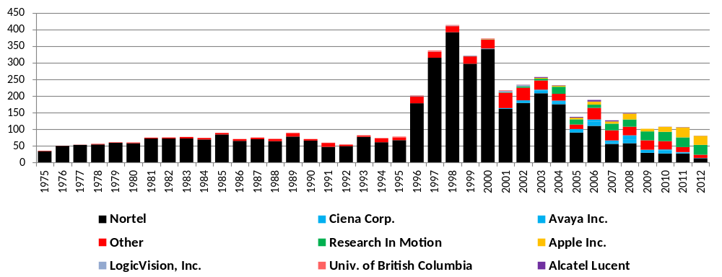
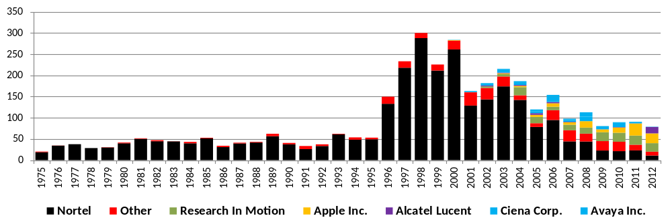
Nortel Inventors – Overall & Ottawa

Slide 12
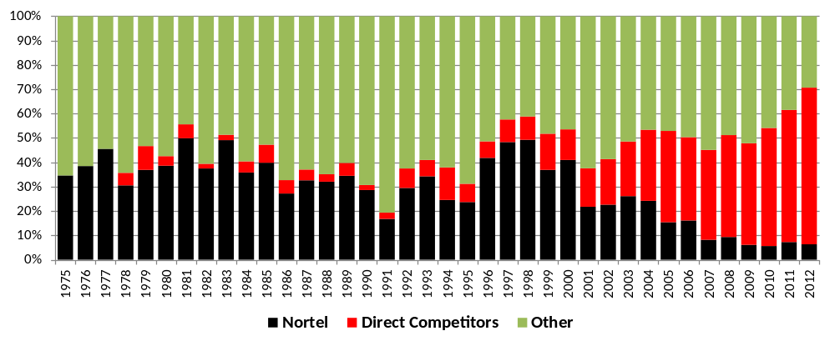
Identify local key competitors
Direct Competitors include:
Alcatel Lucent MOSAID Technologies
Research In Motion International Business Machines
Ciba MagSil
Mitel Networks Apple
Cisco Technology Blackberry
Ericsson Altera

Slide 13
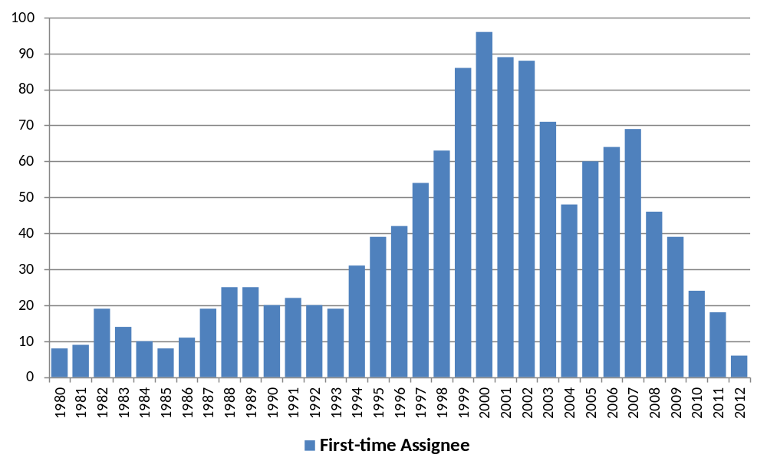
Lack of new firms

Slide 14
Preliminary findings
Nortel’s collapse does not seem to have had a long-term negative impact on the inventive capacity of the Ottawa-Gatineau ICT cluster
A large majority of former Nortel inventors who continued inventing in Ottawa-Gatineau did so for existing large companies in similar technologies
We have found relatively few examples of successful attempts at start-ups from former Nortel inventors, particularly in similar technologies

Slide 15
Discussion and conclusions
The resiliency of the Ottawa-Gatineau ICT cluster appears to be the combination of a diverse set of local competitors as well as a highly talented workforce
  Ottawa-Gatineau also ranks highly of quality of life measures
  Nortel’s competitors bought many of their patents but also acquired much of the talent – in some cases through acquisitions of Nortel’s business units mitigating much of the disruption
Little evidence of entrepreneurship as a source of resiliency
  Technology is capital intensive which may limit entrepreneurial possibilities
Role of policy & government as a stabilizing factor (TBD)
Next steps…examining the impact on inventor relationships

Slide 16
Thank you!
Dieter Kogler – dieter.kogler@ucd.ie
Greg Spencer – greg.spencer@rotman.utoronto.ca

